Slide 1
CIS 4560: Team 2
Term Project Presentation
https://github.com/CIS-4560-Team-2/Hive-on-Yelp
Mohsen Alam | Ben Cevallos | Oscar Flores | Randall Lunetto | Kotaro Yayoshi

Slide 2



Introduction
Descriptive analytics on dataset using
and .
We have run descriptive analytics on the Yelp dataset to find:
How different features of Yelp evolved throughout past decade.
How businesses in different states receive different level of ratings.
What people express in their tips by doing sentiment analysis.

Slide 3
Data Sources
The dataset used for all analyses is provided by Yelp.com:
https://www.yelp.com/dataset/download
The dictionary file used for sentiment analysis is provided by CalState LA BigDAI (HiPIC):
https://s3.amazonaws.com/hipicdatasets/dictionary.tsv
The state-locations file used for improved map location rendering across analyses is provided by Mohsen Alam:
https://drive.google.com/uc?id=1dFrIcQuBhaANRHHvnzbthfU3HHVDRy7Y&export=download
Notes:
GET LINK FROM GITHUB FOR MOHSENS FILE

Slide 4
Hadoop Cluster Specifications
Oracle BDCE
Version 20.3 – 3-20
Total Nodes: 3
Total Node Memory Size: 180 GB
Total OCPUs: 12
Total Storage: 957 GB
Notes:
DR WOO WILL PROVIDE THESE DETAILS **

Slide 5
Workflow
Decide on the project.
Download data from yelp.com/dataset.
Upload data (.tar file) to
Oracle BDCE Server.
Uncompress
the .tar file.
Create new tables and views for analysis.
Create HIVE tables based on the .CSV files and documentation (yelp.com/dataset/documentation).
Upload .CSV files to Hadoop Distributed File System (HDFS).
Copy output tables from HDFS to Local file system.
Copy output files to workstations.
Create 3D Maps and Chart visualizations.

Slide 6
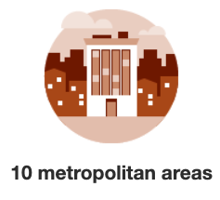

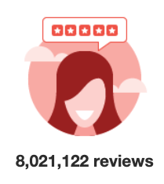
The Dataset
By
Dataset Size: 9.8 Gigabytes
5 JSON Files:
Business.json file → business information: location, categories, attributes…
Checkin.json file → check-in dates and times for businesses.
Review.json file → reviews with users’ and business’ information.
User.json file → information about reviewers.
Tips.json file → short feedbacks from users.
Total Output time to Create and Populate tables from RAW JSON files in Hive:
~3 minutes (161.284 seconds)

Slide 7
Yelp Feature Performance
Analysis 1 – Introduction
Goal:
Measure and illustrate how five of Yelp’s features are trending over time.
How:
Utilize Hadoop (HDFS), HIVE query language, and Excel-Charts.
Extract data from all 5 of the tables in the dataset:
businesses, check-ins, reviews, tips, users.
Metrics determination
Each metrics’ performance per year
Joined report of all metrics
Visualize output in Excel-Charts

Slide 8
Yelp Feature Performance
Analysis 1 – Output table, count by year
Year | New Users | Reviews | Elite Users | Tips | Check-Ins
2004 | 82 | 12 | \N | \N | \N
2005 | 1,022 | 875 | \N | \N | \N
2006 | 6,052 | 5,030 | 896 | \N | \N
2007 | 17,155 | 21,130 | 2,368 | \N | \N
2008 | 34,327 | 56,996 | 3,592 | \N | \N
2009 | 68,314 | 100,760 | 6,369 | 957 | \N
2010 | 115,106 | 186,752 | 10,238 | 41,922 | 393,953
2011 | 185,076 | 302,523 | 12,809 | 146,532 | 1,608,736
2012 | 203,180 | 367,367 | 17,362 | 185,961 | 2,233,001
2013 | 221,380 | 491,678 | 18,223 | 167,643 | 2,665,596
2014 | 250,827 | 702,060 | 20,508 | 163,943 | 2,742,368
2015 | 267,267 | 940,603 | 26,409 | 130,844 | 2,766,769
2016 | 241,414 | 1,094,154 | 32,128 | 145,569 | 2,560,414
2017 | 158,881 | 1,217,292 | 38,645 | 151,006 | 2,307,315
2018 | 122,892 | 1,318,054 | 43,026 | 107,826 | 2,008,051
2019 | 75,728 | 1,215,836 | \N | 78,558 | 1,717,574

Slide 9
Yelp Feature Performance
Analysis 1 – Count by Year

Slide 10
Yelp Feature Performance
Analysis 1 – Conclusion
Key Findings:
4 out of 5 Yelp features measured are trending downward 📉.
‘Elite Users’ feature has the slowest rate increase on average.
‘Check-In’ feature is the most used but is decreasing rapidly.
Output file detail and performance:
Total rows output: 16
Final Output File Size: 18 KB
Total Output time: ~3 minutes (188.179 seconds)

Slide 11
Yelp Tip Sentiment
Analysis 2 – Introduction
Goal:
Evaluate Yelp user’s sentiment on local businesses over time via Yelp’s ‘Tip’ feature (user comments).
How:
Utilize Hadoop (HDFS), HIVE query language, and Excel-3D Maps.
Extract data from the ‘Tip’ table as well as the ‘Dictionary’ and ‘State Location’ files.
Create a dictionary table.
Splitting ‘Tips’ into individual words.
Use ‘Dictionary’ to assign sentiment values for each word.
Aggregate sentiments for ‘Tips’.
Create visualization with ‘Tips’ sentiment and geo-temporal information

Slide 12
Yelp Tip Sentiment
Analysis 2 – Output table snippet
Country | State | Date | Sentiment | Count
USA | Nevada | 1/31/10 | negative | 5
USA | Nevada | 1/31/10 | neutral | 17
USA | Nevada | 1/31/10 | positive | 24
USA | Nevada | 2/1/10 | negative | 3
USA | Nevada | 2/1/10 | neutral | 2
USA | Nevada | 2/1/10 | positive | 3
USA | Nevada | 2/2/10 | positive | 5
USA | Nevada | 2/2/10 | neutral | 1
USA | Nevada | 2/3/10 | neutral | 3
USA | Nevada | 2/3/10 | positive | 3
USA | Nevada | 2/4/10 | positive | 2
USA | Nevada | 2/5/10 | negative | 2
USA | Nevada | 2/5/10 | neutral | 9
USA | Nevada | 2/5/10 | positive | 7
USA | Nevada | 2/6/10 | negative | 2
USA | Nevada | 2/6/10 | neutral | 3
… | … | … | … | …

Slide 13
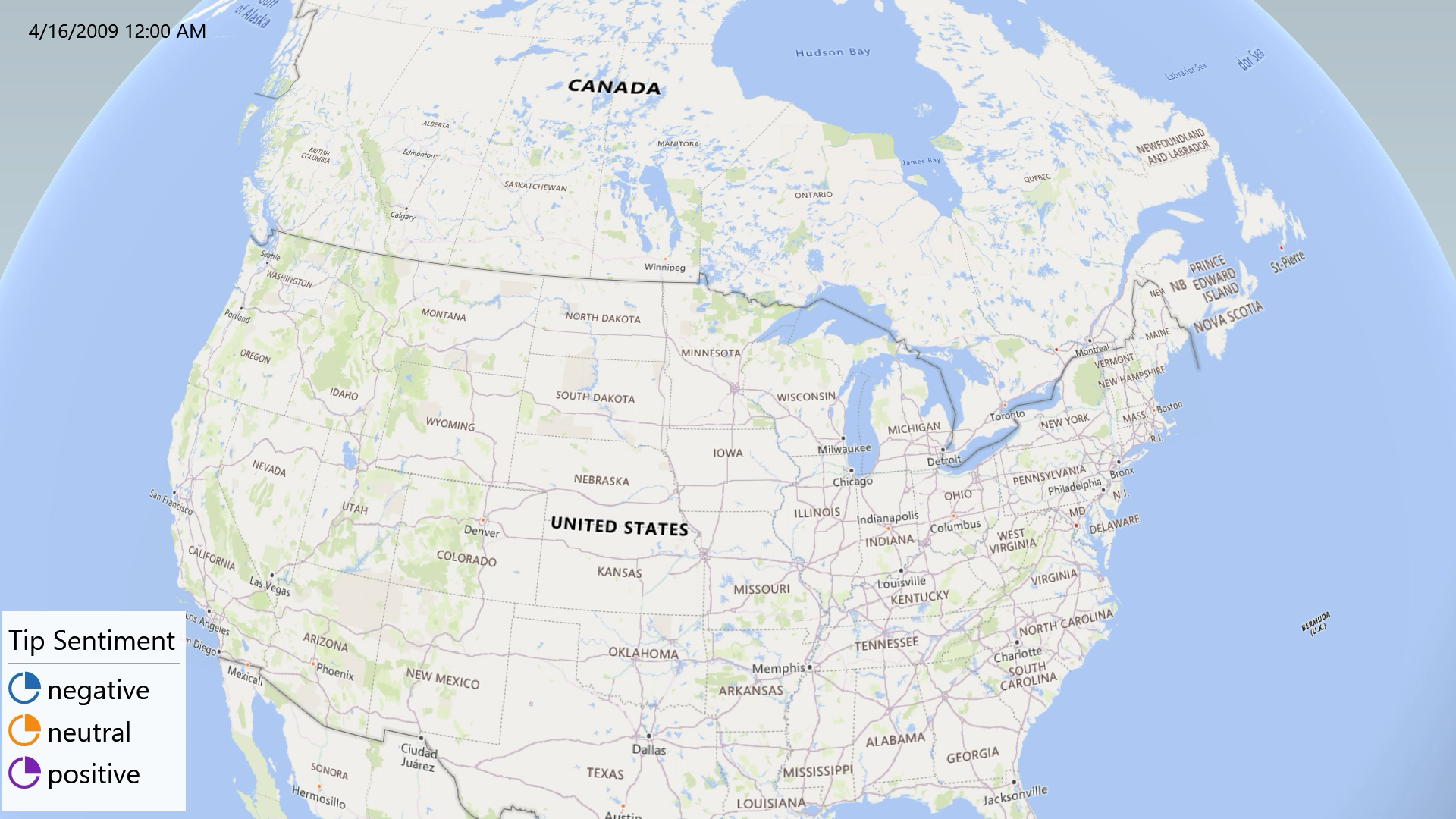
Yelp Tip Sentiment
Analysis 2 – Geo-temporal analysis

Slide 14
Yelp Tip Sentiment
Analysis 2 – Conclusion
Key Findings:
Overall state-wide sentiment breakdown is:
~58.80% Positive, ~28.57% Neutral, ~12.63% Negative
Most states overall conform to this trend with low variance.
Output file detail and performance:
Total Rows: 90,950
File Size: 2.48 MB
Computation Time: ~6 minutes (364.896 seconds)

Slide 15
Yelp Star-Ratings
Analysis 3 - Introduction
Goal:
Identify trends among Yelp’s star-ratings system for businesses across the globe over time.
How:
Utilize Hadoop (HDFS), HIVE query language, and Excel-3D Maps.
Extract data from the ‘Review’ and ‘Business’ tables as well as the State-Location file.
Join 'Review' and 'Business' tables to associate location with 'Review'.
Convert 'Review’ table’s Date format to YYYY-MM.
Aggregate ‘Rankings’ for each ‘Star Ranking’.
Create visualization with 'Review's Ranking' and geo-temporal information.

Slide 16
Yelp Star-Ratings
Analysis 3 – Output table snippet
Country | State | Date | Star-Rating | Count
USA | California | 6/1/10 | 1 | 1
USA | California | 6/1/10 | 4 | 1
USA | California | 6/1/10 | 5 | 4
USA | California | 7/1/10 | 3 | 1
USA | California | 7/1/10 | 4 | 1
USA | California | 7/1/10 | 5 | 3
USA | California | 9/1/10 | 5 | 1
USA | California | 10/1/10 | 1 | 1
USA | California | 11/1/10 | 5 | 1
USA | California | 12/1/10 | 5 | 1
USA | California | 1/1/11 | 5 | 3
USA | California | 2/1/11 | 3 | 1
… | … | … | … | …

Slide 17
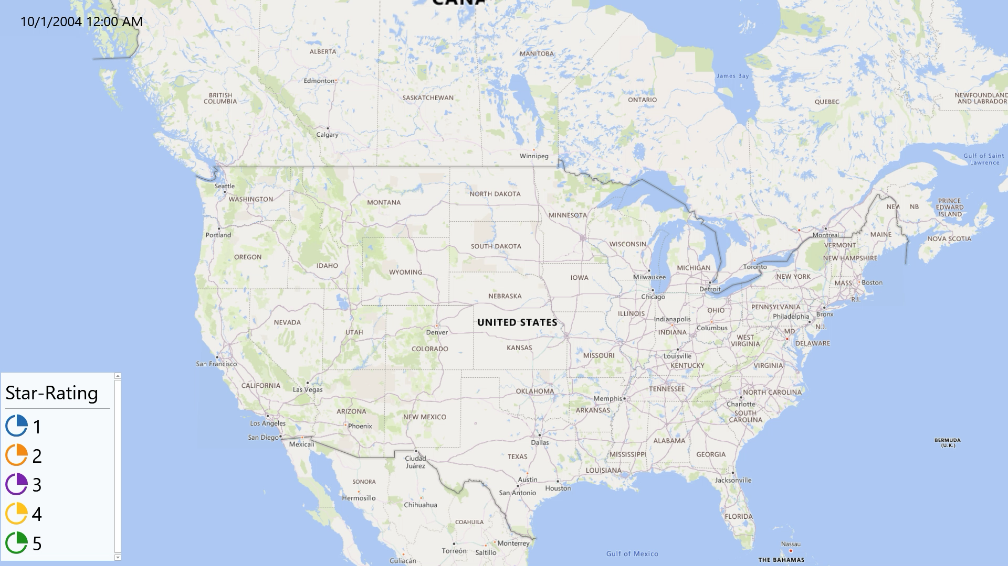
Yelp Star-Ratings
Analysis 3 – Geo-temporal analysis

Slide 18
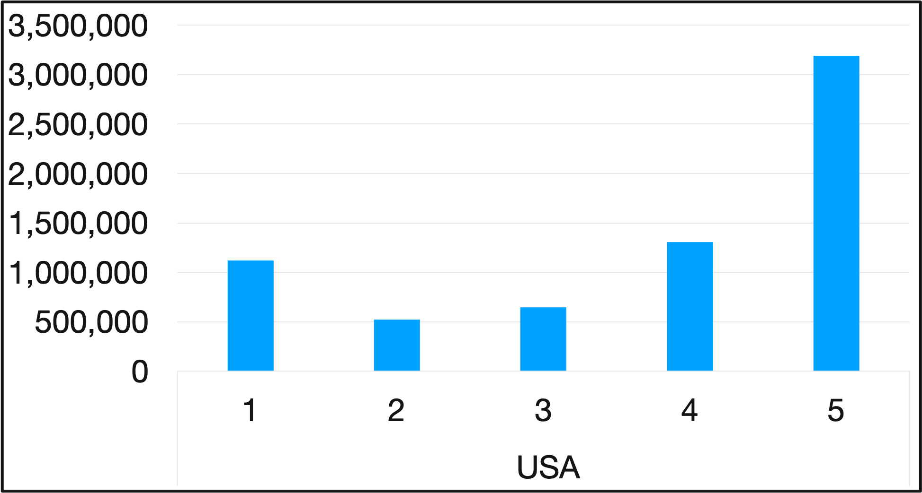
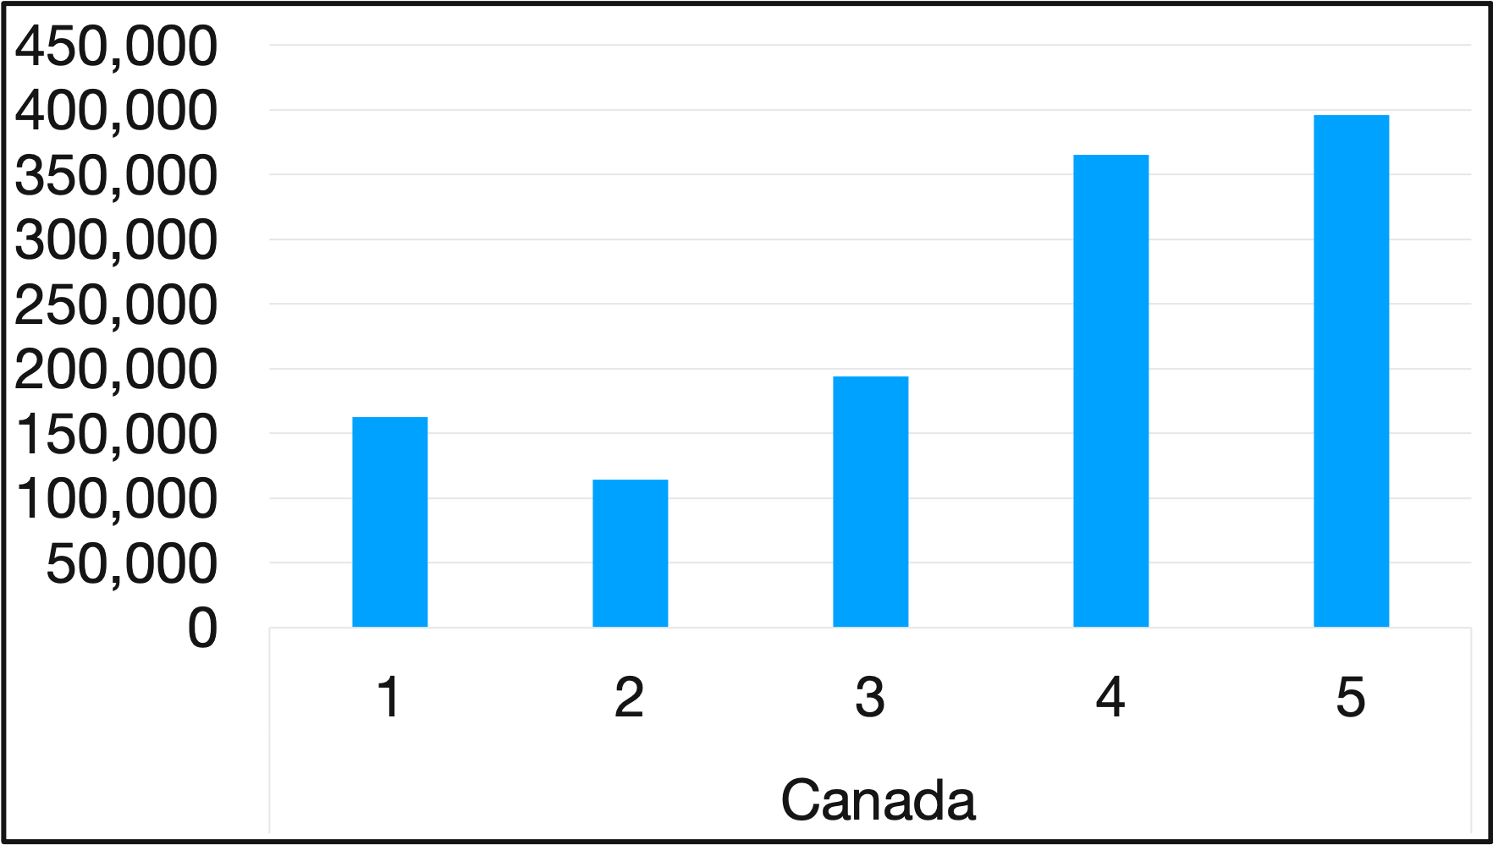
Yelp Star-Ratings
Analysis 3 – Conclusion
Key Findings:
Majority of businesses have 5-Star Ratings.
Canadian business have more consistent differences between star-ratings.
American businesses are more sporadic.
Output file detail and performance:
Total Rows: 9,832
File Size: 1 MB
Computation Time: 56.855 seconds
Count
Count
Star Rating:
Star Rating:

Slide 19
Recap & Tips on Hive
Types of Analysis Performed:
Performance Analysis on Yelp Features
Sentiment Analysis on Yelp Tips
Geo-temporal Analysis on Yelp Ratings and Tip Sentiment
Tips on Hive:
Use Column aliases for the columns with functions to make it easier to call later
Use Order By clause to have only one output file
Use COUNT(distinct) and is null commands to find out if data parsed successfully

Slide 20
Questions?

